Slide 1
Q2 Member Services Webinar
Retirement Process and Pension Overview

Slide 2
Agenda
Retirement
Process
Pension
Pension Presentation by 255 FSPP Board of Trustees
Considerations
Union Support Available

Slide 3
Retirement Process
Getting Started
Before you choose your retirement date, you should consult with your employer (City HR), the LAPP administrator
(Alberta Pensions Services), the FSPP administrator (Lifeworks) and your trusted Financial Advisor.
This is a significant and lasting decision which requires careful planning and consideration. The City of Calgary suggests
you begin this process at least 4 months before your intended retirement date.
Once you have determined the optimal date for your retirement, you should notify the City of Calgary (City HR) to
begin the retirement process.
What Constitutes an Optimal Retirement Date?
Decide how to handle any accrued vacation and Retirement allowance [Art. 11.05/11.06]
Last Day of Work and Last Day of Pay (discuss difference)
Start date with the city [prior service]
Subjective [Years of service, Health, Financial situation]
Unique [Age, Family, Hobbies]

Slide 4
Retirement Process Continued
After contacting City HR, they will send you your “Retirement Guide” which contains step by step instructions to help guide you through the retirement process as well as the relevant contact information.

Slide 5
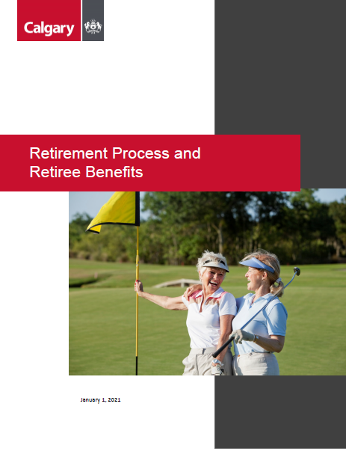
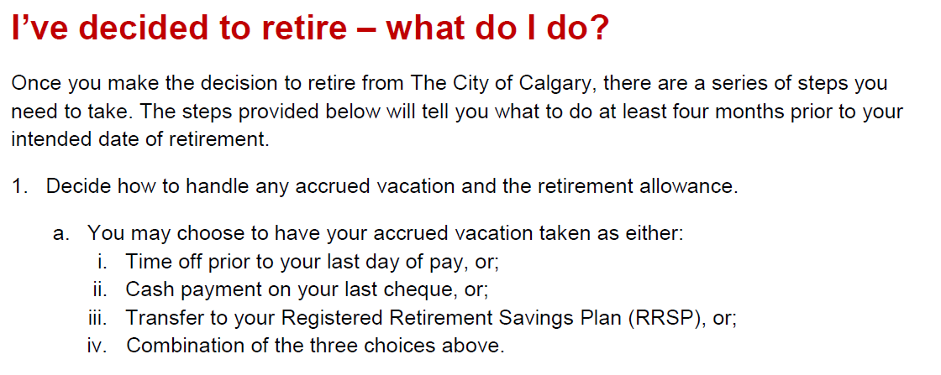
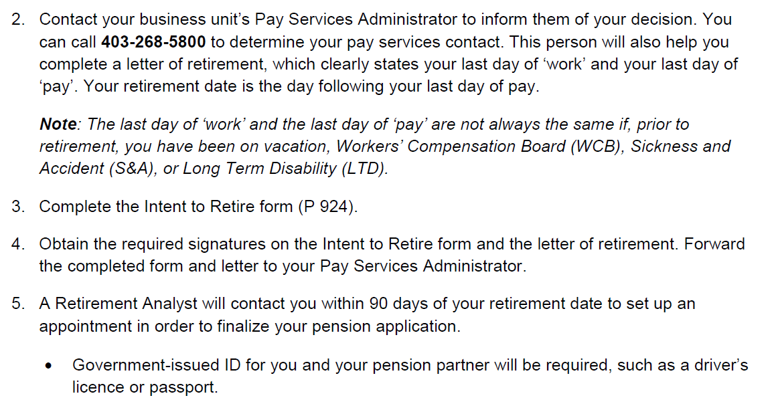

Slide 6
Step by Step Process
Call LAPP and FSPP to confirm your employment dates and numbers
Call Pay Services Administrator (Charlene Jones Bastian) via City HR line ((403)268-5800)
Discuss Retirement date. How do you plan to allocate Accumulated Leave (Vacation) and Retirement Allowance? What you choose to do with your Accrued Time and Allowance will determine Last Day of Work and Last Day of Pay
Complete Intent to Retire Form (P924)
Complete Retirement Letter
Send Form and Letter to Chiefs Office (sheilah.daniels@Calgary.ca) for signatures
Chiefs Office sends back to Pay Services Administrator (Charlene Jones Bastian)
Pay Services Administrator sends to Retirement Analyst
Retirement Analyst calls member within 90 days of retirement date to finalize Pension Application (LAPP Form LA21, FSPP Request and Consent to Release Information Form, Banking, Benefits and Beneficiary information)
LAPP/FSPP calculate members numbers and send them an Option Package to their home address

Slide 7
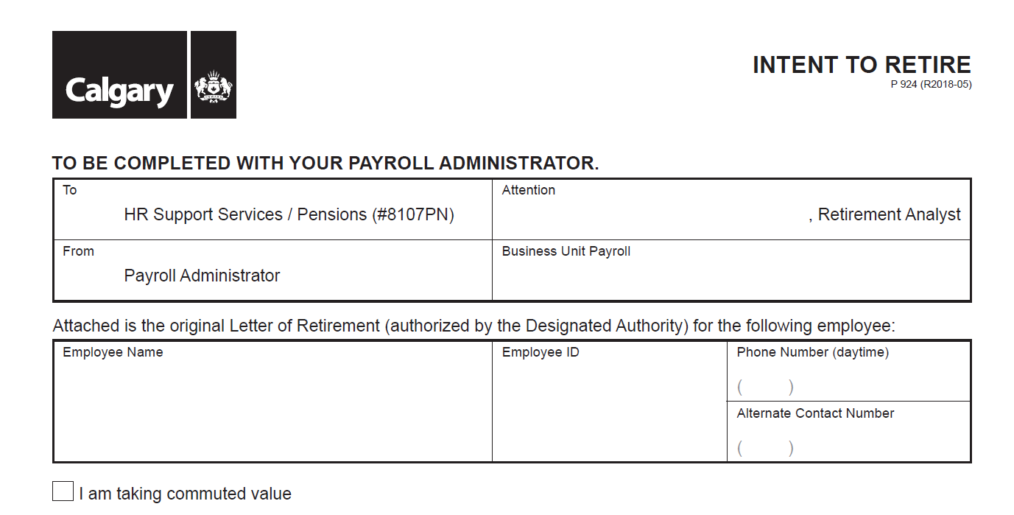
Intent To Retire Form

Slide 8
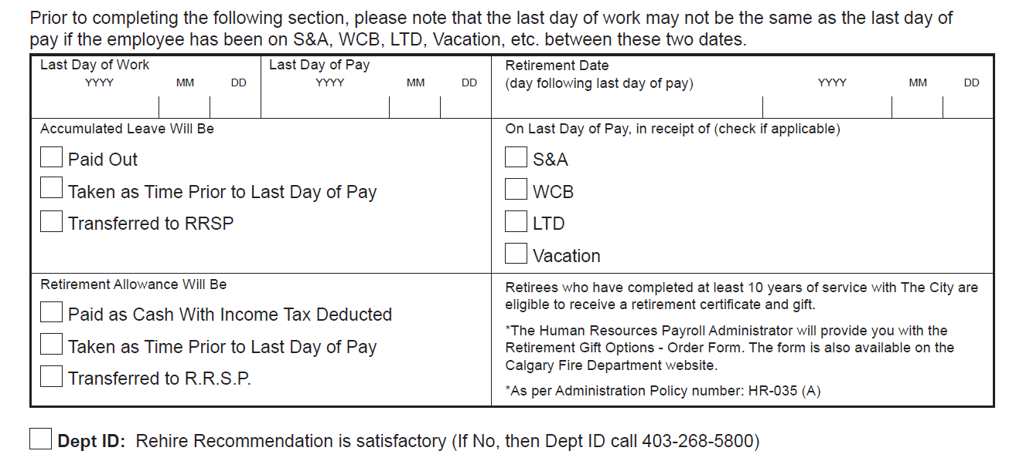

Slide 9
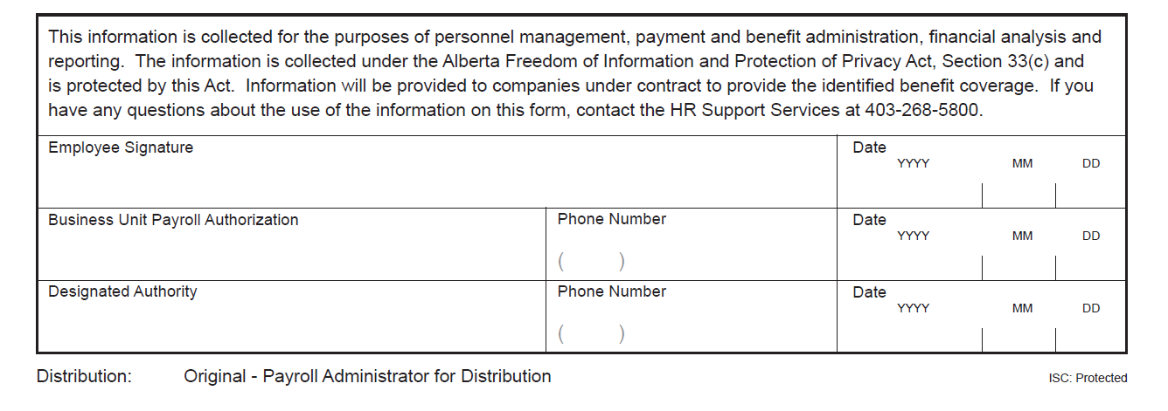

Slide 10
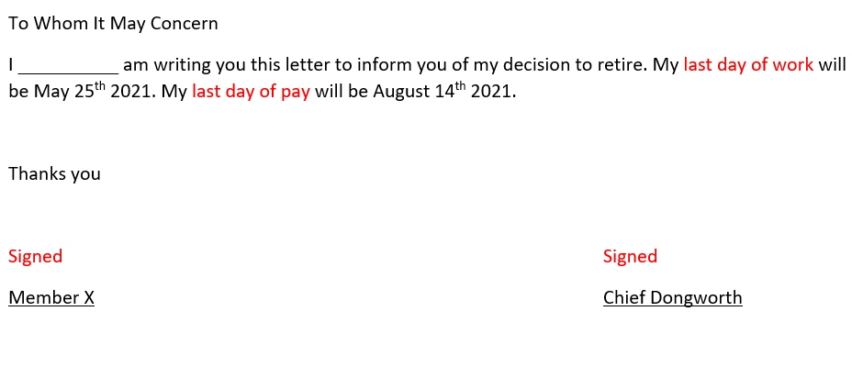
Letter of Retirement Example

Slide 11
Retirement Analyst Initial Contact

Slide 12
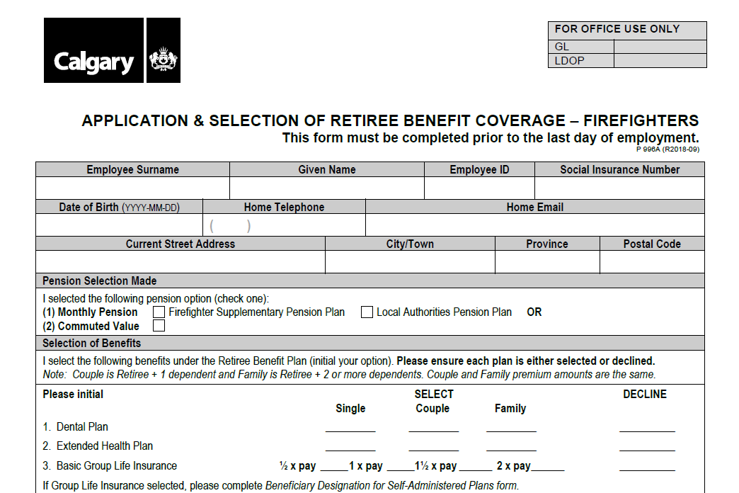
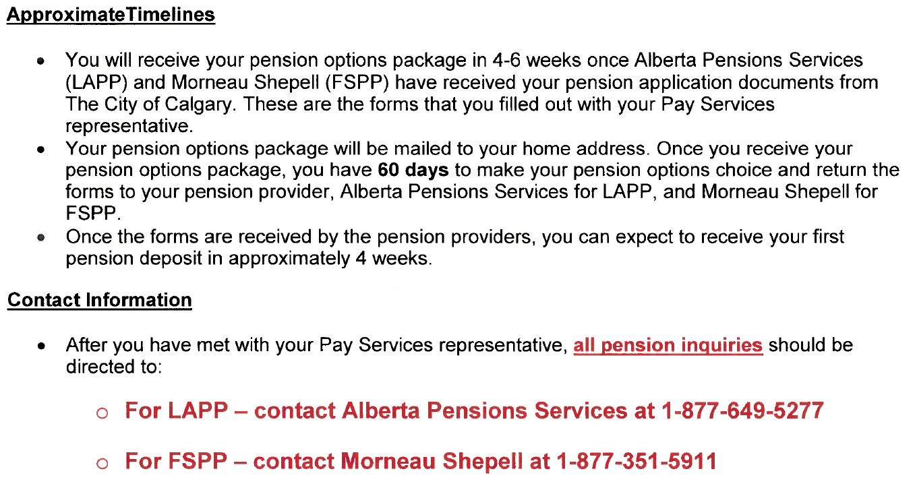
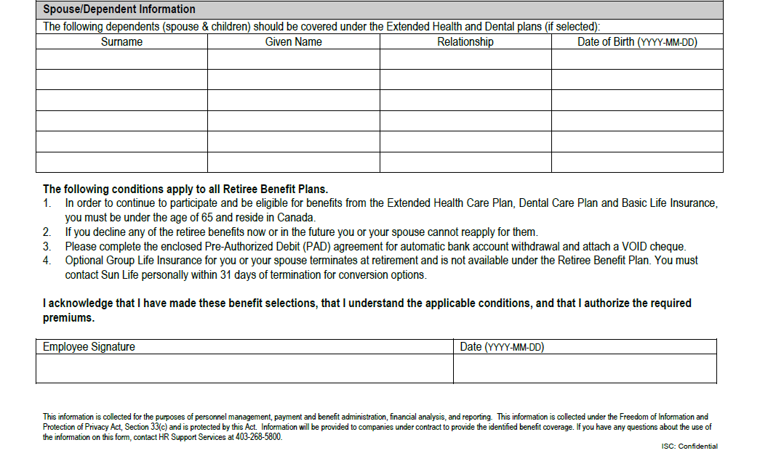

Slide 13
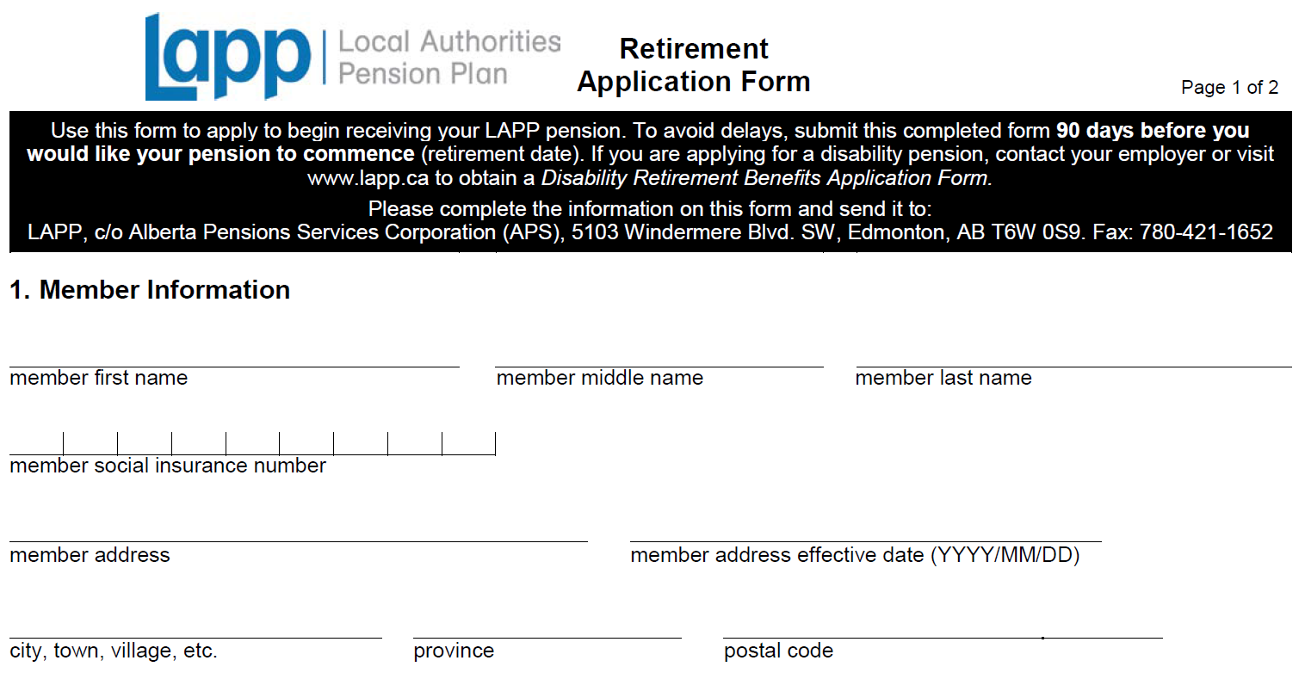
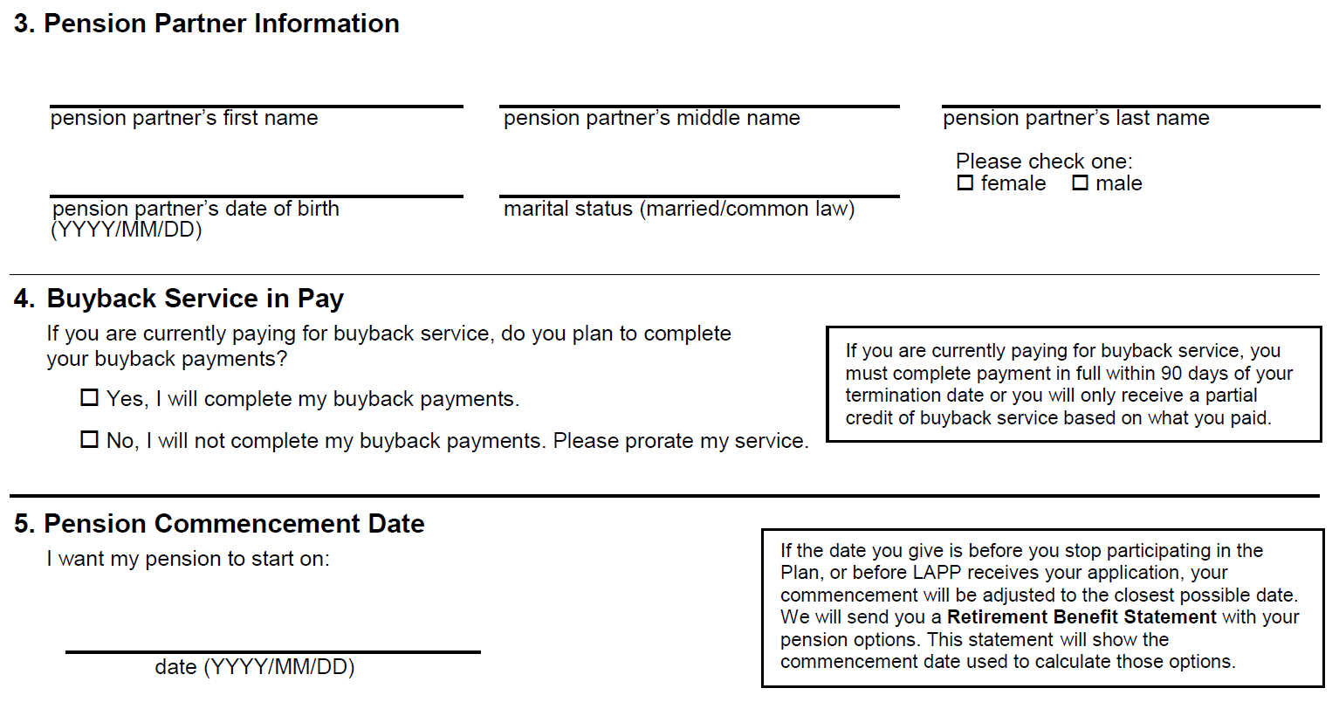
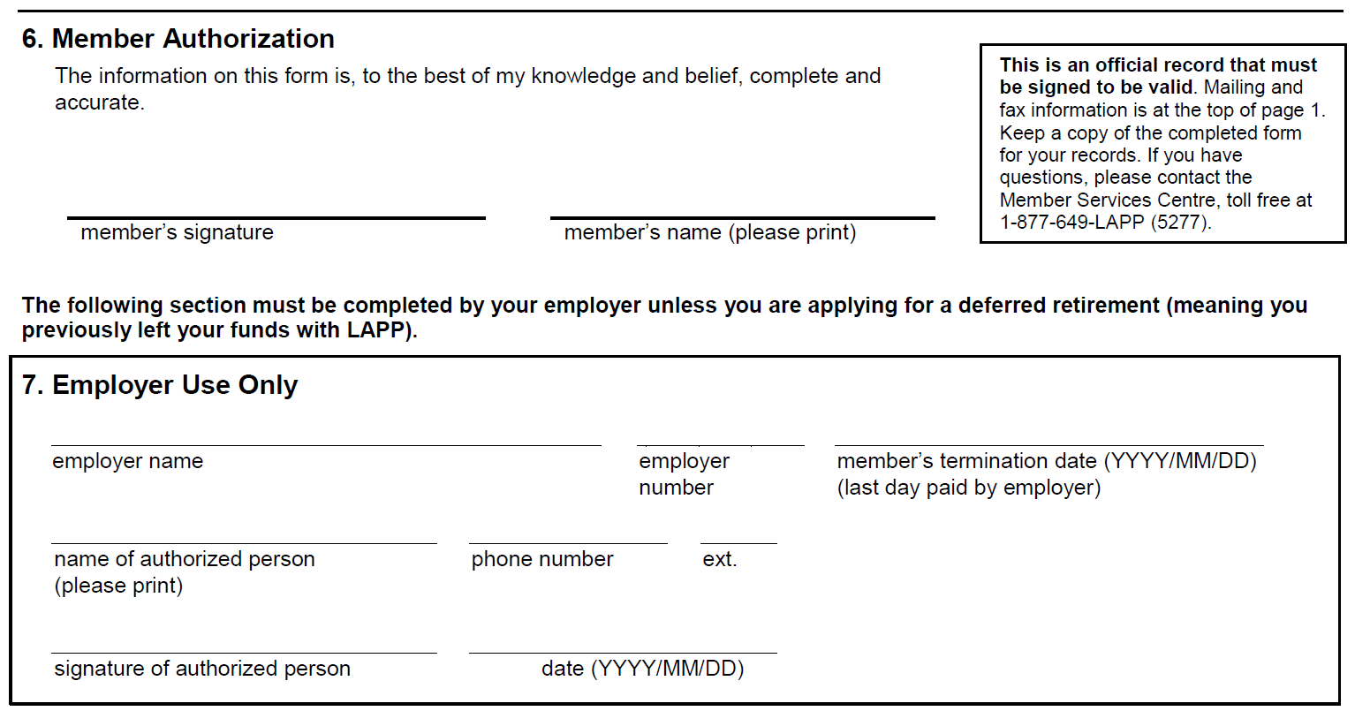

Slide 14
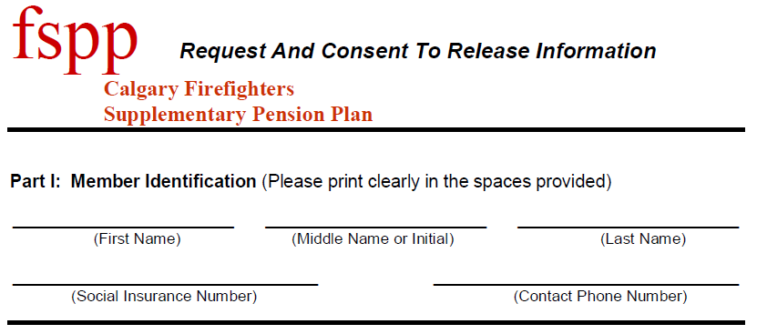
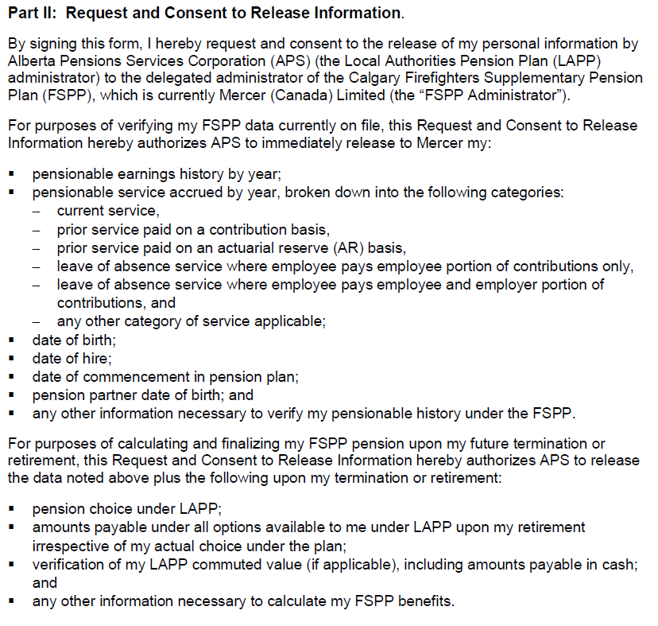
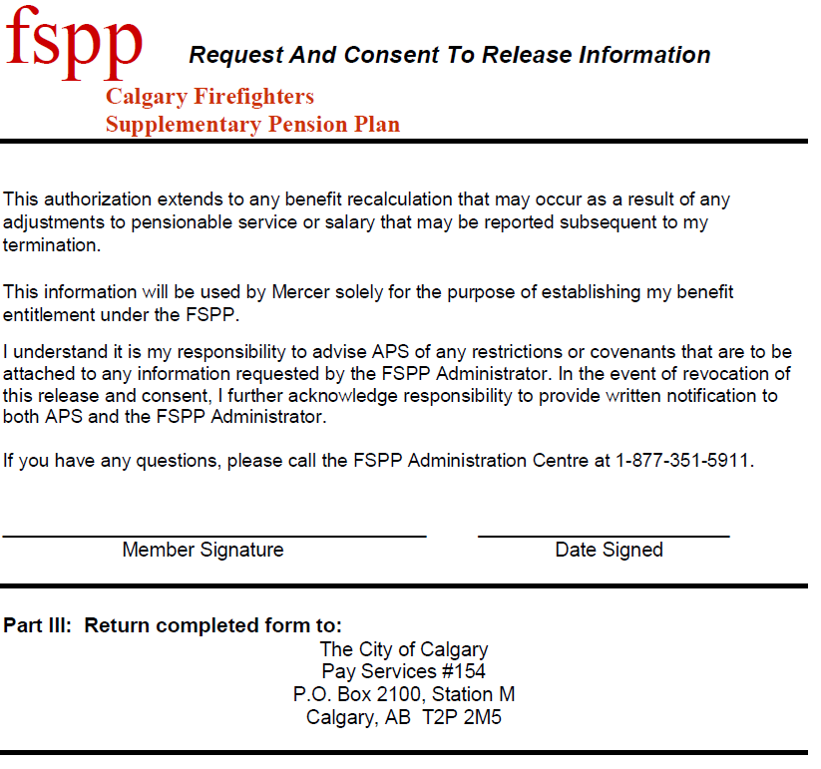

Slide 15
Retirement Considerations
Retirement Benefit Plan
Prior to retirement you will have to decide what kind of benefit plan you would like and from whom. This includes Prescription Drug, Extended Health and Dental benefits as well as Life Insurance
The City offers an optional benefits plan to Pensioners that acts as a bridge between early retirement and access to Government benefits at age 65 or for a maximum of ten years. Whichever comes first
The application is sent to you by your Retirement Analyst. Opting in or out is entirely optional. They will go over this with you
Choosing your Pension Plan
Pension overview up next

Slide 16
Pension Administrator Contact Information
City HR (403) 268 - 5800
Consulting your personal financial advisor will help you plan for the financial aspects of retirement. Additional financial advice is available
Through The City of Calgary – Employee and Family Assistance Program (EFAP)
LAPP (877) 649 - 5277
The LAPP Corporation has a lot of excellent information on their website, LAPP.ca
(LAPP administrator is Alberta Pensions Services)
FSPP (877) 351 - 5911
The Calgary Firefighters Supplementary Pension Plan (FSPP) has additional information on their website at FSPP.ca
(FSPP administrator is Lifeworks)

Slide 17
Union Support Available
Annual Pension Information Presentation
Generally in late May
Presentation by Mercer (Defined Benefit Pension Experts? )
Pension Trustees
Tristan Shanks Ph.# (403) 615 - 0552
Andrew Cutforth Ph.# (403) 464 - 2420
Jamie Blayney Ph.# (403) 466 - 0463
Local 255 Member Services Executives
Rob Miller Ph.# (403) 969 - 1879
Royal Slade Ph.# (403) 682 - 9807
Marco Ficaccio Ph.# (403) 819 - 4422
Greg Peter Ph.# (403) 862 - 5749

Slide 18
End of Retire Process Overview. Questions?

Slide 19
Pensions 101 for L255 Members
Our Pension Plans
Calgary
Notes:
Intro

Slide 20
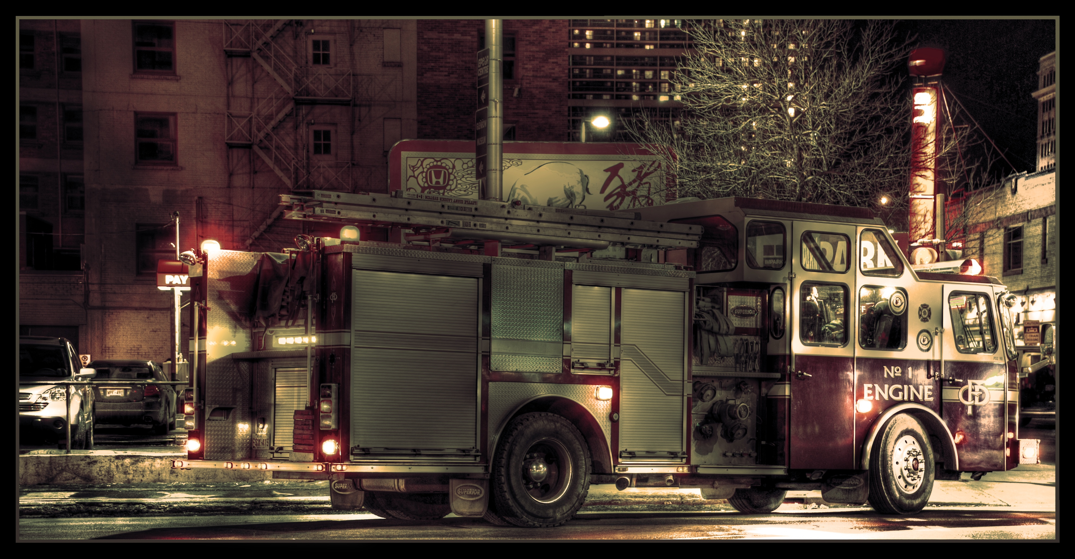
Why Do We Need a Good Pension Plan?
There are basically three types of sources you might have for retirement income:
A pension you receive from an employer, if available (LAPP/FSPP)
Modest retirement benefits provided to you by the government (CPP/OAS)
Your own savings that you accumulate over time (RRSP/TFSA/Other)

Slide 21
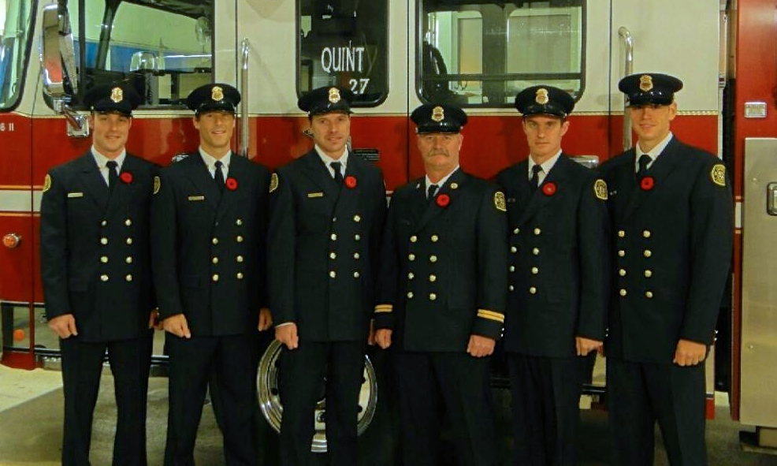
Pension Plan Participation
Calgary Firefighters participate in 2 separate pension plans:
The Local Authorities Pension Plan or “LAPP”, and
The Calgary Firefighters Supplementary Pension Plan or “FSPP”
Notes:
- Total benefit delivered through two separate pension plans

Slide 22
Why Do Local 255 Members Have Two Plans?
LAPP
Public sector pension plan for municipalities, health sector, and others
City of Calgary is a participating employer
Common benefits for all participating employees – this is our base plan
No ability to customize benefits for different segments of an employer’s workforce – this is why we need our FSPP
FSPP
Pension plan that is supplementary to LAPP that adds extra coverage
Only participants are City of Calgary Firefighters
Through collective bargaining process, provides customized benefits that recognizes the specific needs of the firefighters
Notes:
LAPP – common benefits for all, no customization
FSPP – provides customization for the Calgary Firefighters

Slide 23
Why Do We Care About the Structure?
LAPP and FSPP are separate pension plans:
They have different benefits
They have different contribution requirements
Due to privacy rules, the FSPP administrator does not have access to LAPP pension data
The administration of the FSPP is therefore separate from LAPP
This means that Calgary Firefighters must deal separately with two different pension administrators*
*Important - remember, you must deal with both administrators
Notes:
Privacy rules prevent LAPP from sharing data with FSPP.
At each life event (retirement, death) you will therefore need to deal with two administrators.
Is more complex, but relatively speaking, these are good problems to have.

Slide 24
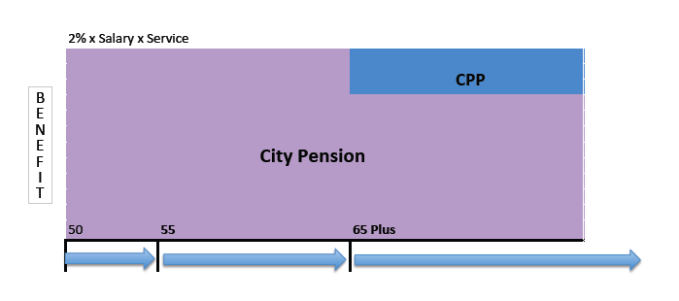
History of the FSPP (Prior to 1974)
Notes:
Prior to 1974, all City of Calgary employees enjoyed the benefits of a City of Calgary Pension. City of Calgary employees did not belong to the provincial LAPP plan at that time.
In early 1972, the City chose to move all of its employees to the LAPP.
This action was detrimental to the interests of employees because pension benefits were not as good under the LAPP as they were under the City pension plan.
The Firefighters Association went to “interest (contract) arbitration” with a goal of maintaining a DB pension with a retirement benefit equal to 2% of salary per year of service. (60% after 30 years or 70% after 35 years)
The arbitrator ordered the City to provide a Supplementary Pension Plan (FSPP) in order to preserve the former 2% pension benefit for the Firefighters.

Slide 25
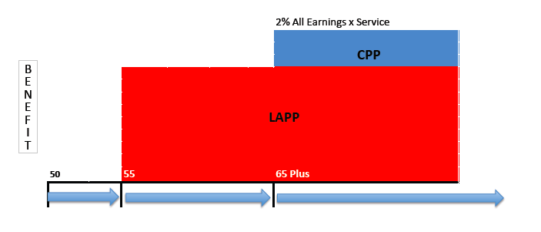
History of the FSPP (where the City wanted to go)

Slide 26
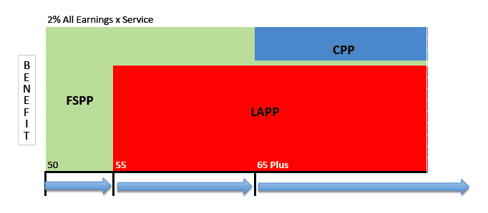
History of the FSPP (after the 1974 arbitration)

Slide 27
Plan Overview

Slide 28
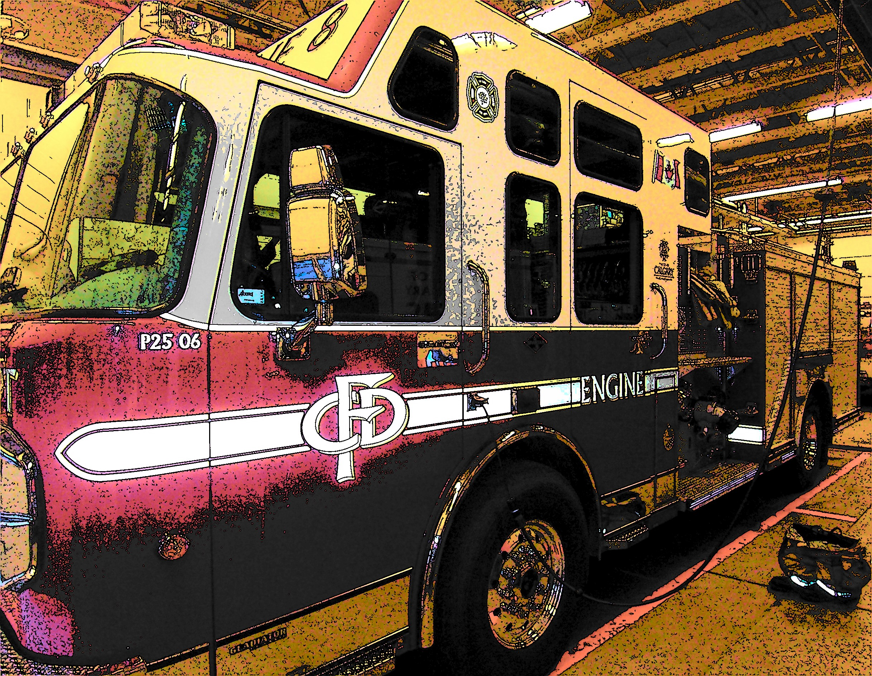
Defined Benefits
Both LAPP and FSPP are DB pension plans
This means that when you retire, the amount of pension that you will receive is determined by a formula
The formula is based on
The average of your highest five consecutive years of pensionable salary, and
Your years of pensionable service
The pension is paid for your life, regardless of investment returns
Notes:
DB pension formula is based on your individual earnings and pensionable service

Slide 29
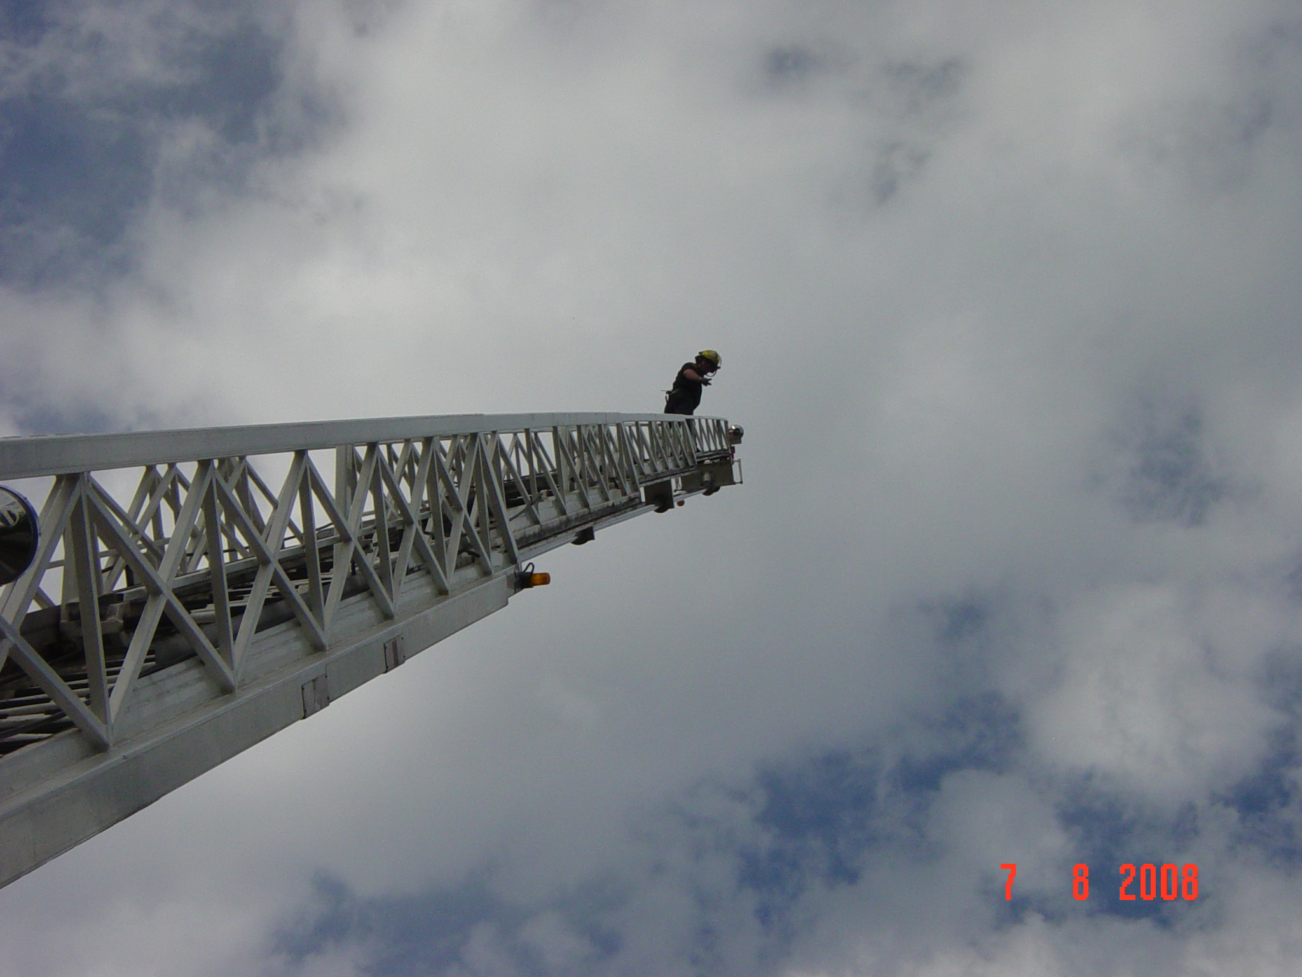
Contributions
Both you and the City of Calgary, as your employer, are required to pay contributions into LAPP and FSPP
For LAPP, the City of Calgary pays 1% of pay more than firefighters
For FSPP, the City of Calgary pays 55% and firefighters pay 45% of the total cost
Your pension contributions are tax deductible to you
Notes:
Current cost sharing rule between FF and City, which accommodates variable contribution rates.

Slide 30
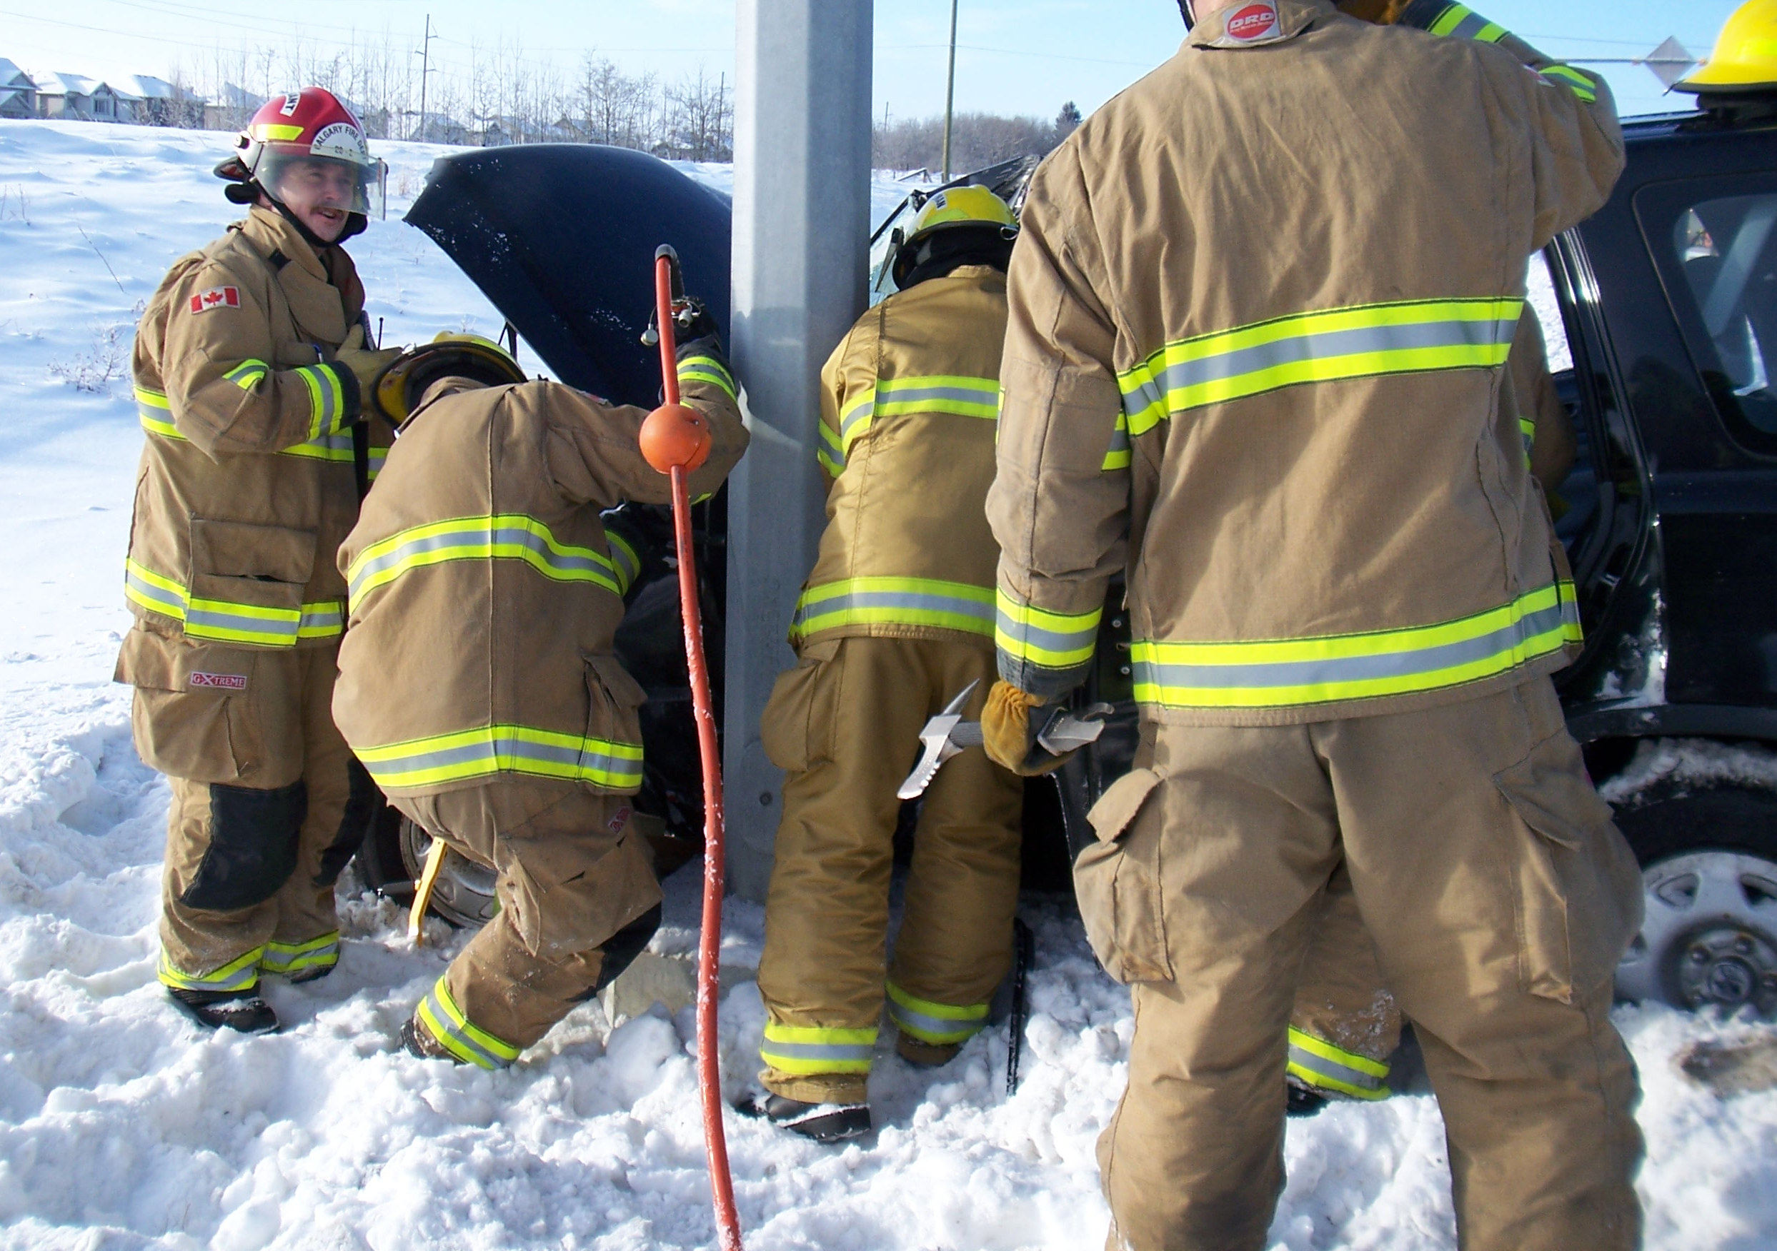
2021 Contribution Rates
 | LAPP |  | FSPP
 | Employee | Employer | Employee | Employer
Total Contribution Rate | 9.58% | 10.58% | 2.32% | 2.83%
Notes:
Contribution rates may fluctuate over time depending on plan experience

Slide 31
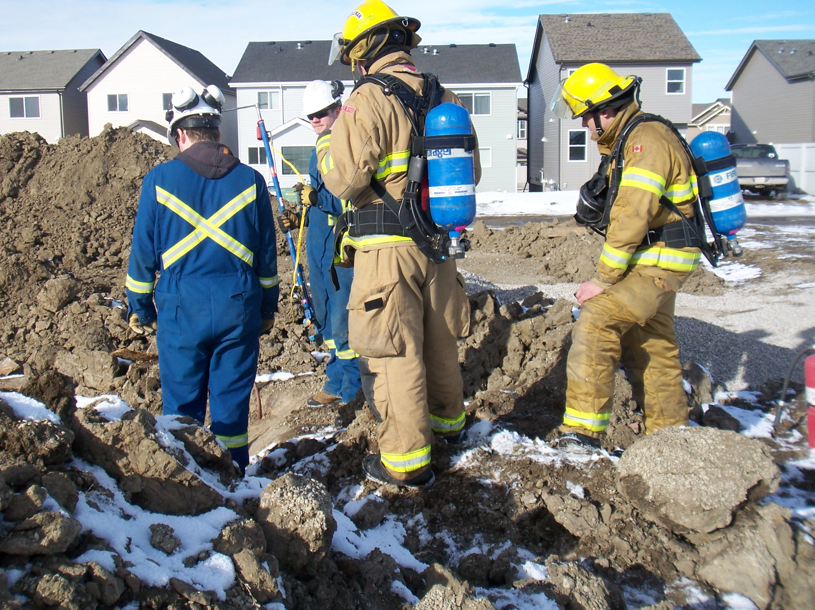
How Do LAPP & FSPP Work Together?
Think of the FSPP as:
a plan supplemental to LAPP, that
provides additional benefits not provided under LAPP, primarily in the area of:
Early retirement
Survivor benefits
Bridge benefits
In aggregate the two plans together provide the total benefits just described
Notes:
Recap: LAPP + FSPP = Total Benefit
LAPP = core
FSPP= customization

Slide 32
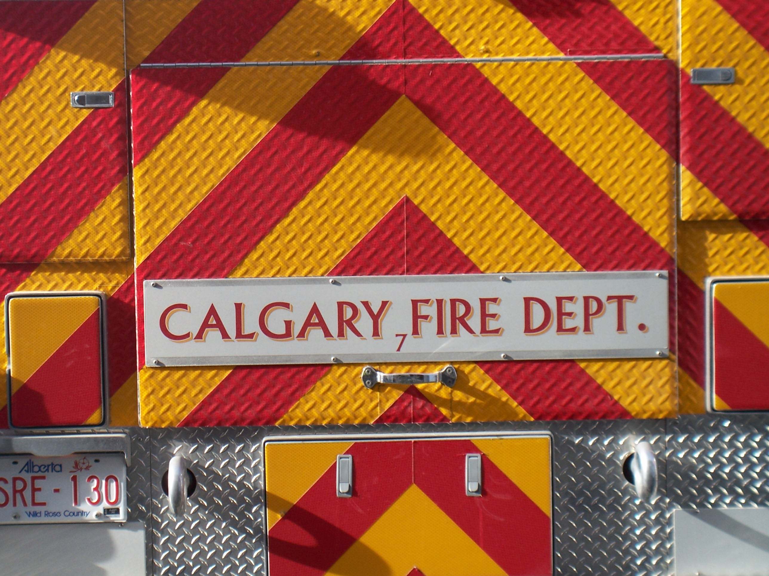
Retirement Eligibility Under LAPP
In LAPP you can retire if you
Have reached age 55
You cannot start your LAPP pension before age 55
You are entitled to an unreduced pension under LAPP if
Your age plus LAPP pensionable service totals 85 (“85 Factor”)
For example, a member who starts with CFD at 25 years old, and retires at age 55, will have30 years of service. So, 55 (age) + 30 (service) = 85
If you’re under the “85 factor”, your pension benefit is reduced under LAPP
This is where our FSPP can “supplement” our pension!
Notes:
The interaction between the plans can be confusing.
One major source of confusion arises on early retirement, whether unreduced or reduced.
Recall that the total benefit promise allows you to start your pension before age 55. This is not the case with LAPP, so FSPP as we will see, provides the pension to age 55.

Slide 33
How Do LAPP & FSPP Work Together? Single Member – Unreduced in LAPP AND FSPP
Age at Retirement: 50
Service at Retirement: 30 years
Marital Status: Single
Highest Average Salary: $100,000
Entire Pension
is paid from
FSPP prior
to age 55
Offset at age 65
`
FSPP pension
reduces once
LAPP pension
commences
at age 55

Slide 34
What If You Want to Retire Before 30 Years of Service?
If you don’t have 30 years of service, you can retire under FSPP with no early retirement reduction provided you are at least age 55
If you have less than 30 years of service, you may have less than 85 points under LAPP, depending on your retirement age
For example, if you have 27 years of service and are age 55, you will have 82 points under LAPP
If you have 27 years of service and are age 58, you will have 85 points under LAPP
If you have less than 85 points under LAPP and retire on or after age 55 under FSPP, the FSPP plan will “pick up” any reduction under LAPP to ensure that when both plans are added together, you still have an unreduced pension

Slide 35
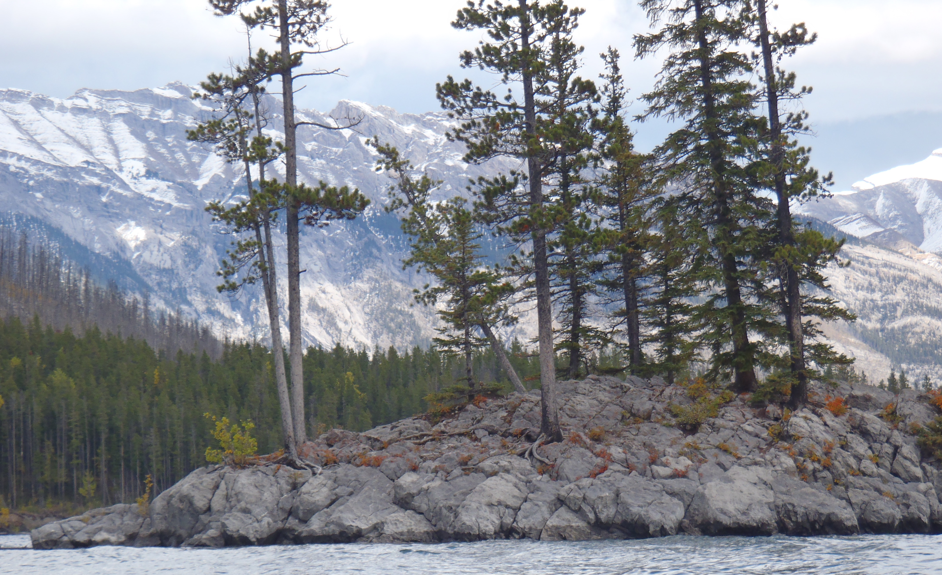
FSPP Forms of Pension Single Member
If you don’t have a spouse (Pension Partner), the normal form of pension under both LAPP and FSPP is a lifetime pension to you, with a guarantee of 5 years
A guarantee of 5 years means that if you die before receiving 5 years of payments, the balance of the 5 years will be paid
You can elect other single life optional forms, on an actuarial equivalent basis
Life only (increases your benefit, but only while you’re alive)
Longer guarantee periods (10 and 15 years - will decrease your benefit, but guaranteed for a longer period)

Slide 36
FSPP Forms of Pension Member With a Spouse (Pension Partner)
If you have a spouse (Pension Partner), the normal form of pension under FSPP provides for a spousal pension of 65% should you die and your spouse is still living:
To get this normal form under FSPP, you must elect the Joint Reducing by 1/3 form of pension under LAPP
This LAPP optional form reduces by 1/3 on the earlier of your death, or your spouse’s death
If your spouse predeceases you and you elected the LAPP Joint Life Reducing by 1/3 form, your LAPP pension will reduce (even though you are still living)
FSPP will then provide an additional top up benefit to ensure that your lifetime pension is not impacted by your spouse’s death
The normal form of pension also provides a 5 year guarantee

Slide 37
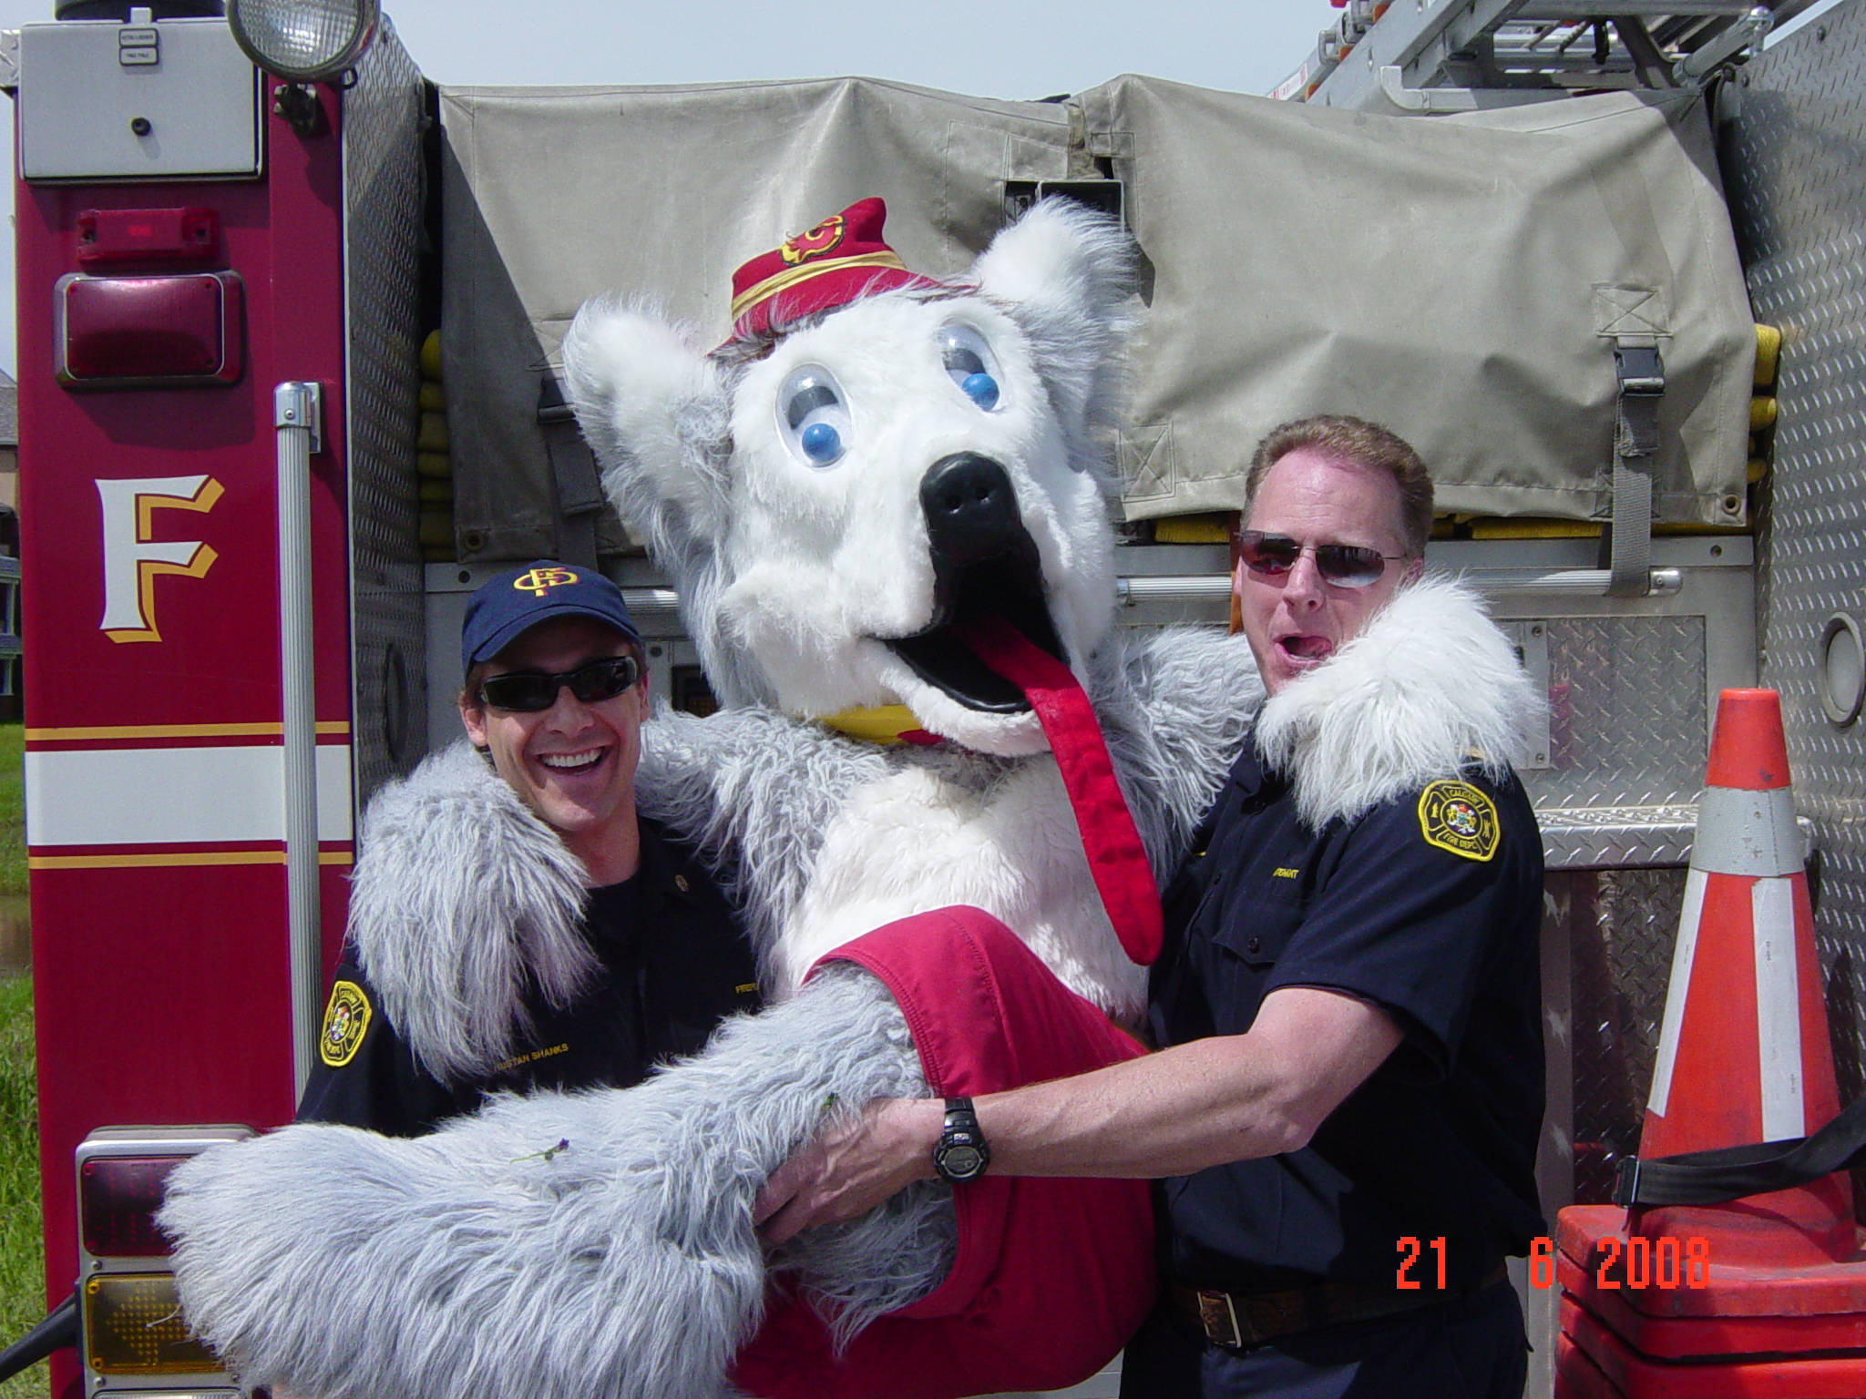
FSPP Forms of Pension Other Option for Member With a Spouse
You may also elect an optional form under both FSPP and LAPP that provides for a 100% survivor pension
You must elect this same form in both FSPP and LAPP
Your FSPP pension will be adjusted so that it has the same actuarial value as the normal form pension
Similar to the guarantee, you “pay” for the extra survivor pension by taking a reduced lifetime pension

Slide 38
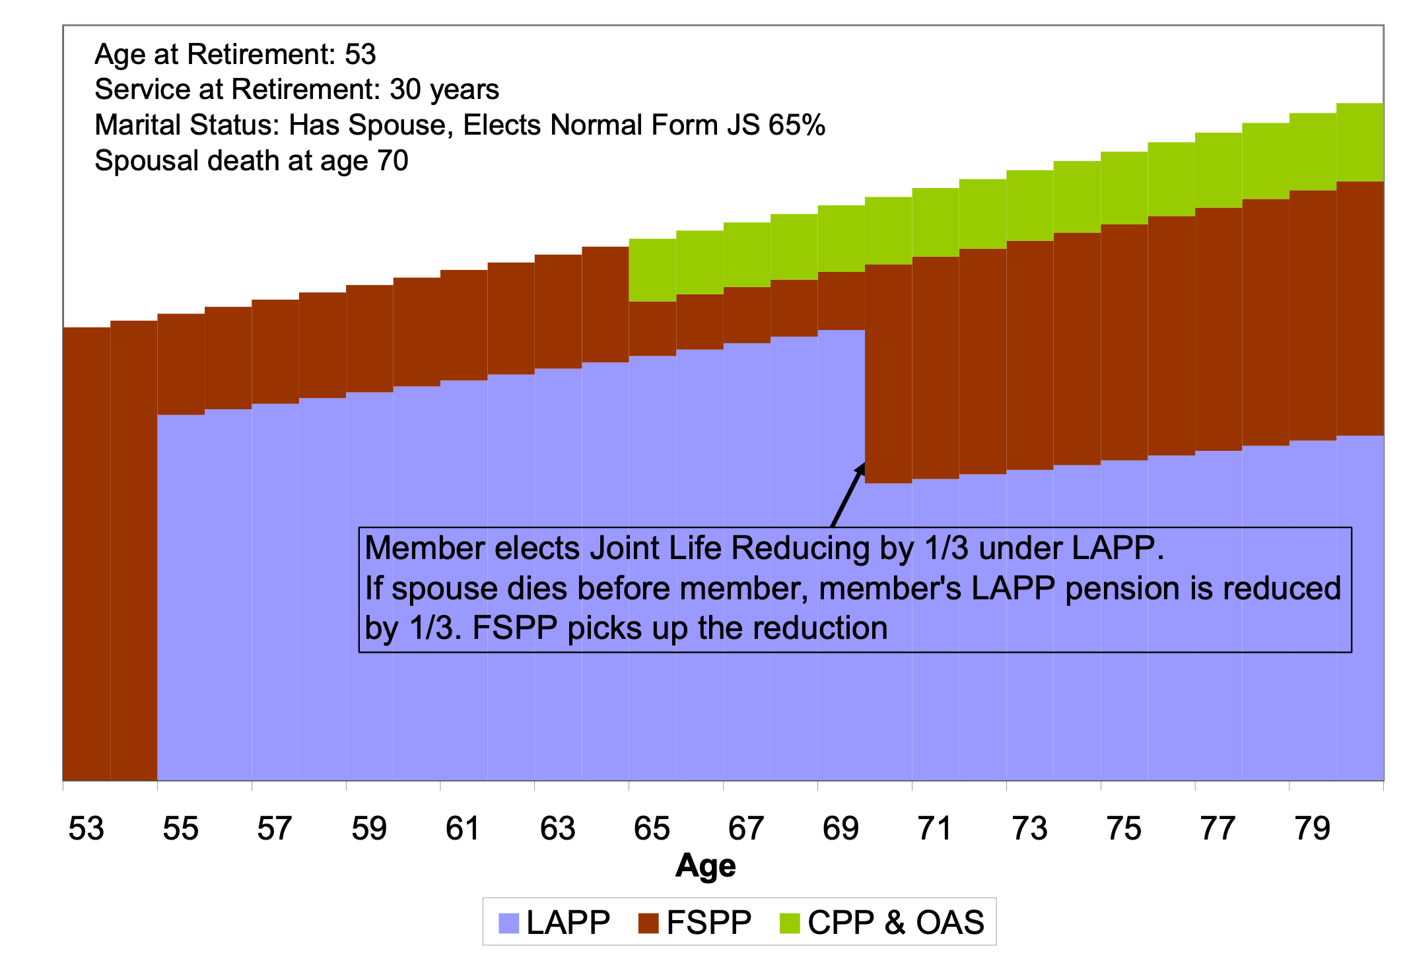
How Do LAPP & FSPP Work Together? Normal Form Pension is Chosen and Spouse Dies First

Slide 39
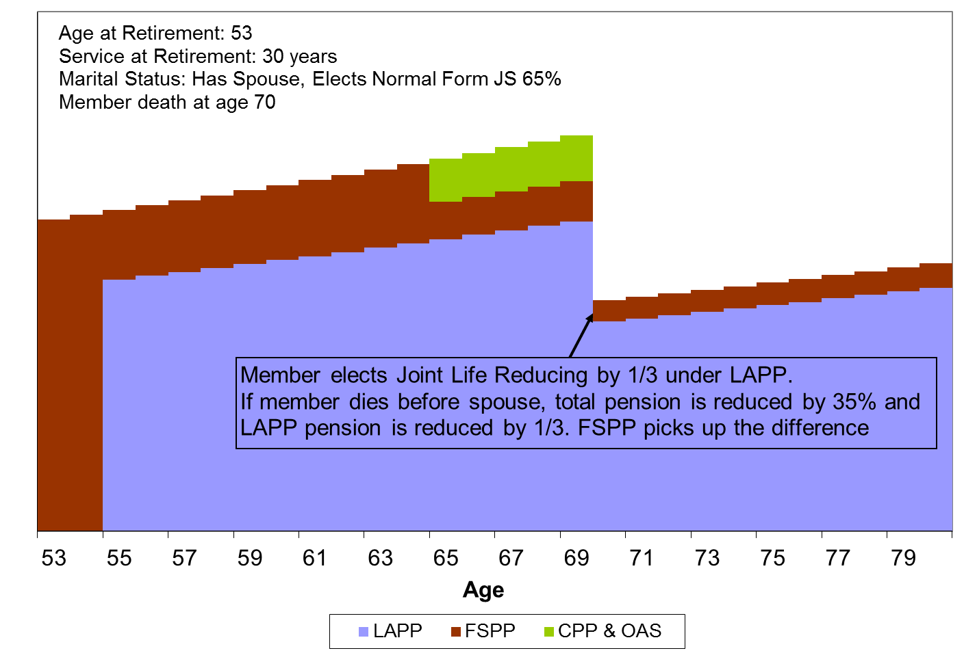
How Do LAPP & FSPP Work Together? Normal Form Pension is Chosen and Member Dies First

Slide 40
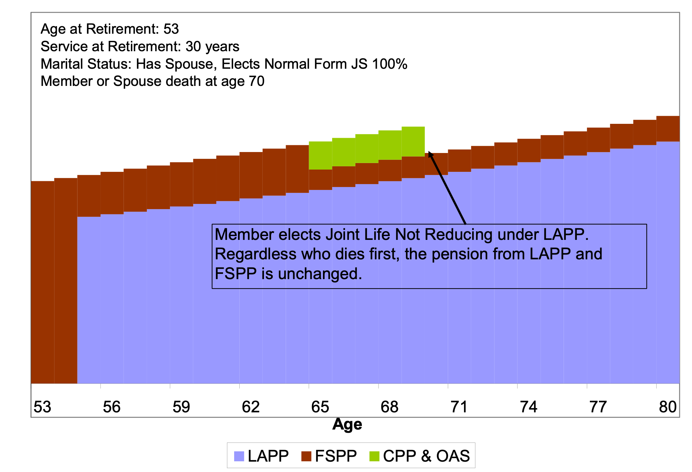
How Do LAPP & FSPP Work Together? J&S Pension Without Reduction is Chosen Spouse or Member Dies First

Slide 41
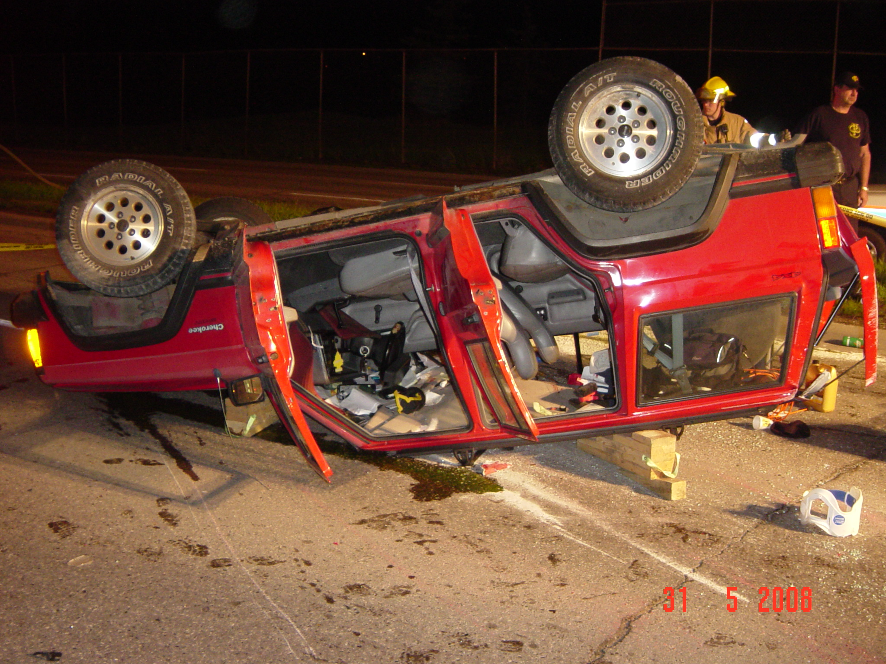
Termination Benefits
If you terminate employment but you are not eligible to retire, you will have a choice between a deferred pension or a transfer of value from the plan
The transfer is referred to as a commuted value
Most of the time, all or a portion of the FSPP commuted value must be paid in cash, subject to immediate tax withholding
This is because the tax authorities restrict the amount of commuted value payments from pension plans and most of your available tax sheltering room is used up under LAPP
You cannot elect a transfer if you terminate after age 50

Slide 42
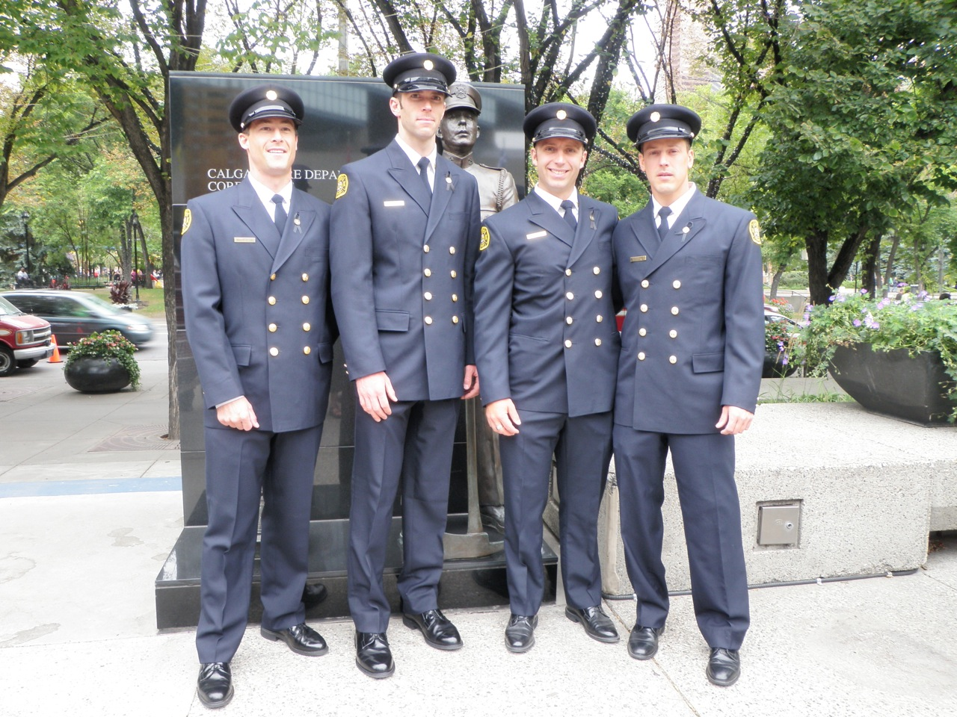
Pre-Retirement Death Benefits
From date of hire, Local 255 Members have immediate survivor pensions available (65% to your surviving spouse and either 10% or 15% to any dependent children (15% if there is no spouse))
In this case, the immediate pension is based on service projected to your age 60
The commuted value of the total benefit payable will not be less than the commuted value that you would have been entitled to had you terminated employment immediately prior to death
Your spouse or, if there is no spouse, your beneficiary, may elect to receive the commuted value that you would have been entitled to had you terminated employment immediately prior to death.
Notes:
Spouses should know what these options are, and receive unbiased advice regarding any choice to be made during what would be a stressful period.

Slide 43
Purchasing Prior Service

Slide 44
Prior Service
Prior service is eligible service with another employer prior to joining the plan or service with the City of Calgary prior to becoming a Firefighter
If you worked with the City of Calgary or another LAPP employer before becoming a Firefighter, you may already have service in LAPP. This is not prior service in LAPP (you already have it), but is eligible prior service in FSPP
In order to have prior service be credited as pensionable service in FSPP, you must purchase the prior service in FSPP
Purchasing service in LAPP does not mean you have purchased the service in FSPP
You must separately purchase the service in FSPP
Any prior service purchased in LAPP must also be purchased in FSPP

Slide 45
Purchase of Service Payment Options
You may have a choice to pay for your purchased service in instalments, rather than an immediate lump sum
The longest instalment payment period is the earlier of:
The period of service you are purchasing
Your age 60
15 years
You will be given your payment options when you request a purchase of service calculation
Instalment payments must be set up with the City of Calgary as payroll deductions

Slide 46
Retirement Process

Slide 47
Retirement Process
Before you choose your retirement date, you should consult with your employer (HR), the LAPP administrator (Alberta Pensions Services), the FSPP administrator (Morneau Shepell) and your trusted Financial Professional. This is a significant and lasting decision which requires careful planning and consideration
Once you have determined the optimal date for your retirement, you should notify the City of Calgary (HR) to begin the retirement process
The City of Calgary will notify the FSPP administrator of your decision to retire and they will prepare and mail a retirement option statement, listing all FSPP payment options available to you
You will receive a separate communication from APS regarding your LAPP options

Slide 48
End of Pension Overview. Questions?

Slide 49
What Makes Up Your Pension?
LAPP (Local Authorities Pension Plan)
FSPP (Fire Supplemental Pension Plan)
CPP (Canada Pension Plan)
Note – DB Pension means “Defined Benefit” Pension

Slide 50
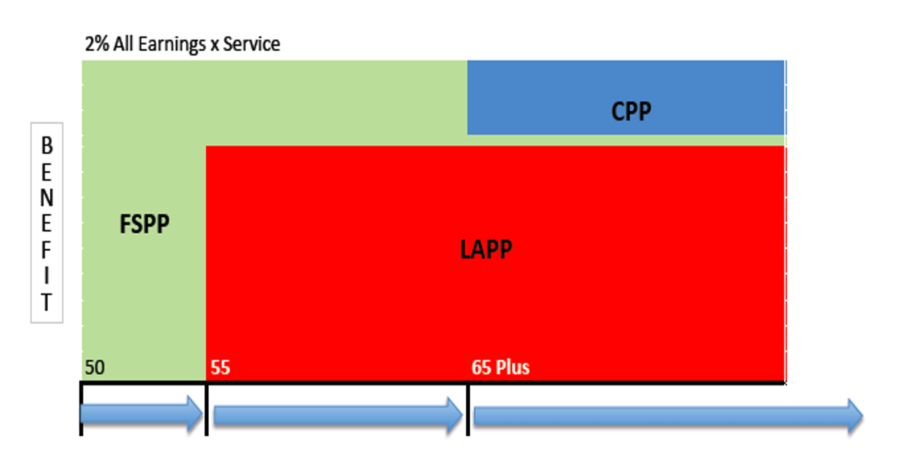
Visual Example

Slide 51
Retirement With LAPP Only

Slide 52
How FSPP “Supplements” Your LAPP Pension

Slide 53
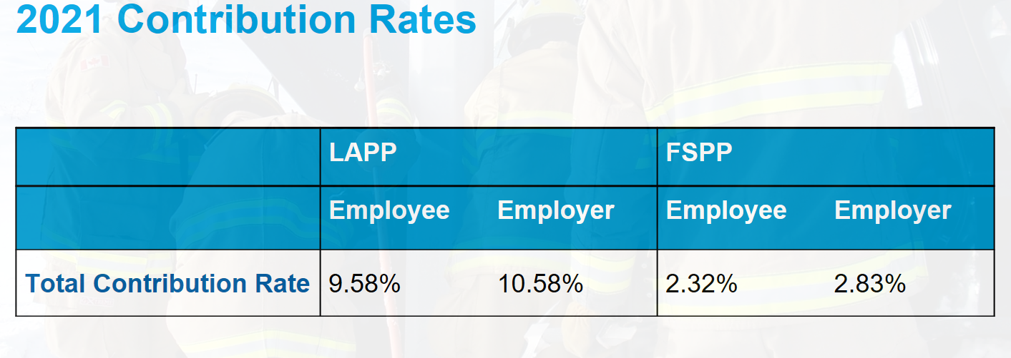
Who Pays For Your Pension?
The simple breakdown is the Employee pays 45% over their career and the Employer pays 55%

